Slide 1
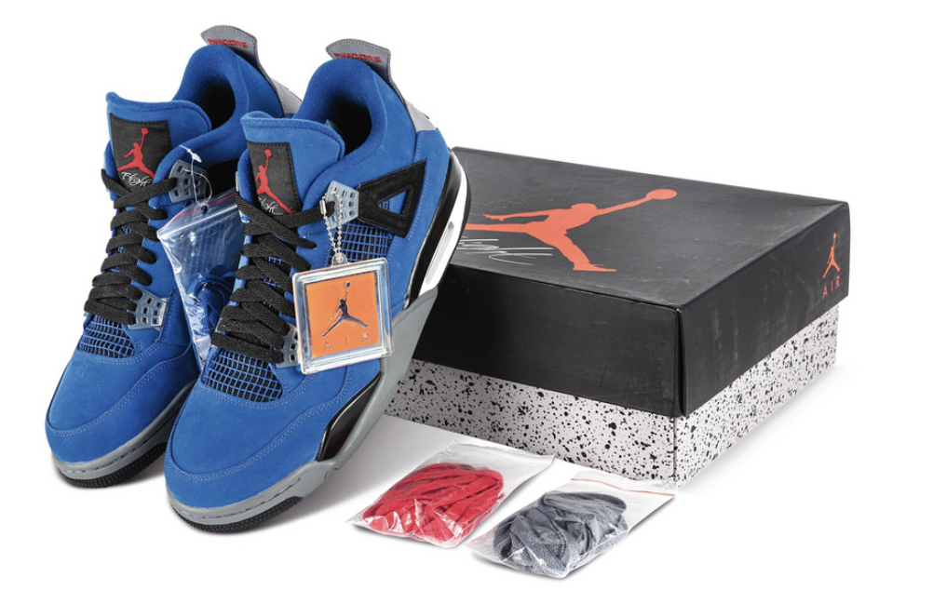


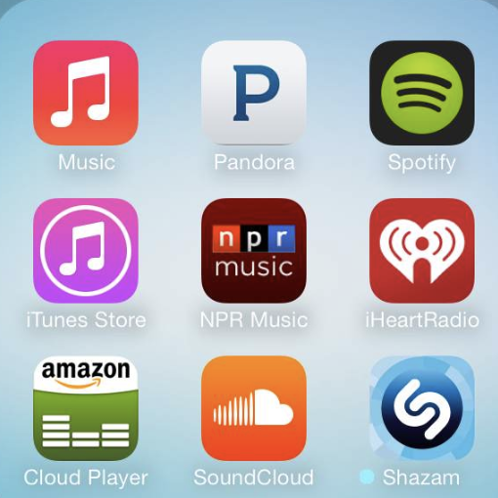
Finance
Michael Jordan collaborating with Nike in making Jordan Sneakers is a massive hit!
Similarly, Dan Gen Music
the Collab of the Gen AI + Dan Productions + Artist can be fire!
1.Investments Generation -Angle Investor -Crowdfunding -Business Pitching -Venture Investments(Once established) | 2.Cost Structure -Artist & Tech Pay -Technology Infrastructure -Studio Operational Bills -Legal, Insurance and paperwork -Marketing
Cash Generation -Profits | Loss Prevention Incase of Loss
Goal
Product Development
Vision To have an ecosystem that enables the audiences to enjoy the music produced by Dan | Mission To Create a product to enhance the quality of music in Dan’s production with GenAI
-Research & Development -Human AI Interaction -Study -Educating the AI 1.Types of Mixing mastering the music 2.All kinds of sound. 3.With Algorithm to bring controlled permutations & Combinations of music
Operations 1.Following Corporate hierarchy and rules. 2.Managing all the departments of all hierarchy levels.
Value Proposition To Create a product the enables artists and audience to make and listen good music cost effectively
Product Engineering(Key Resources) Techie building AI AI + Artist + Dan’s music magic = Dan Gen Produced Music
Distribution
Audience Selection: Since the app is about music -Right Genre Music to right audience -Singers/Artist with high quality need of production music with low budget. -Based on Age/trends/favs
Strategies of distribution -Direct/Indirect -Selective/Intensive
Marketing -Social Media -CRM’s -Digital Marketing -Traditional Marketing’ -Media Marketing -Customer Relationship Partnerships Building Partnerships with artists or an Organization to promote
+ Dan’s Magic + GenAI

Slide 2
What are the key challenges that you faced in developing Product Canvas?
Enhancing knowledge about the product
Enhancing knowledge on the market
Basically, it is creation of a product design which involves deep understanding in the field.
Creativity in designing the canvas
To put out the concepts from vision to every knowledge on the product in piece of paper is challenging

